Slide 1
Indian Equity Short Term Trading Models
(Group 44)
Aditya Prasann
Rghvendra Goyal
Nilbabul Patel

Slide 2

Nilbabul Patel

Slide 3
Raghvendra Goyal
I am a professional trader with experience in discretionary and automated trading and currently building infrastructure and strategies for a algo trading startup in India.
Email: raghvendragoyal@gmail.com

Slide 4
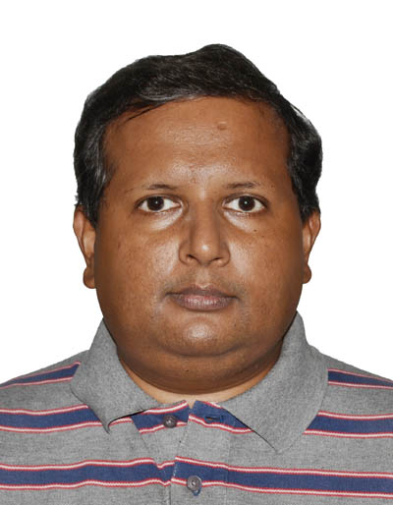
Aditya Prasann
I am a software engineer by qualification and profession. I have keen interest in evolving programming paradigm and their role/application in finance industry. I professionally work as development manager in short term interest rates trading for Citibank.
Email - aditya.prasann@gmail.com

Slide 5
Project Goal and Importance
Design and implement short term trading portfolios of NIFTY50 stocks based on various short term trading strategies primarily based on trending and mean reversion.
Select portfolio of stocks with optimum returns.

Slide 6
Literature Review/Background
Lots of research done in Equity and FX pricing.
Machine learning is next new frontier
Automation in market place has lead to market efficiency.
Recent technological advances lead to overhaul of NSE.
NSE offers one of the fastest order matching systems.
Highly suitable for algorithmic trading.
Short term equity trading models trained on NIFTY50 can be helpful in better understanding of algorithmic trading in NSE.

Slide 7
Assumptions and Choice of Technology
Data:
15 minutes market data samples for NIFTY50 from August 1, 2017 to April 30, 2018
Market data filtered for futures expiry dates and corporate actions.
Technology:
Python for development
BackTrader - Event driven trading strategy back testing framework.

Slide 8
BackTrader
Well documented, community supported backtesting framework.
Supports various data formats.
Simultaneous data feeds supported.
Multiple timeframes can be mixed and run.
Integrated Resampling and Replaying.
Event based.
Vectorised calculations for indicators.

Slide 9
Peer Review Feedback
Methodology section was required.
Our final project submission now incorporates methodology section. Below are main points under methodology section:
Data: 15 minutes NIFTY50 stocks price samples used adjusted for futures expiry and corporate actions.
Strategies implemented:
SMA
TRIX
Stochastic Reversal
Three Green Candles

Slide 10
Summary of Results
TRIX:
Tripple exponential moving averages
Simple moving average of data series (first data series)
SMA of first series at chosen period (second data series)
Exponential moving average (EMA)
Trading signal generation:
Calculate rate of change:
TRIX = (DXi+1 - DXi)/DXi+1
Signal = EMA(TRIX)

Slide 11
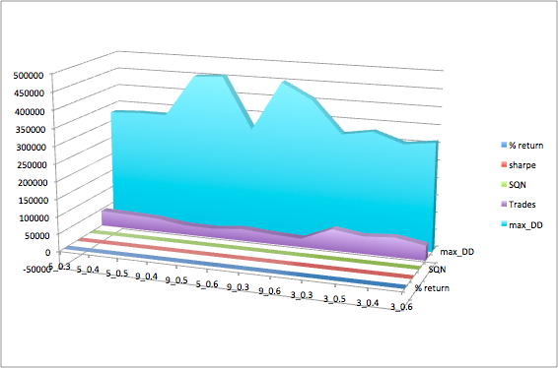
TRIX Results
Mostly successful strategy.
Mostly positive returns with in the -5.14% to 21.99% range

Slide 12
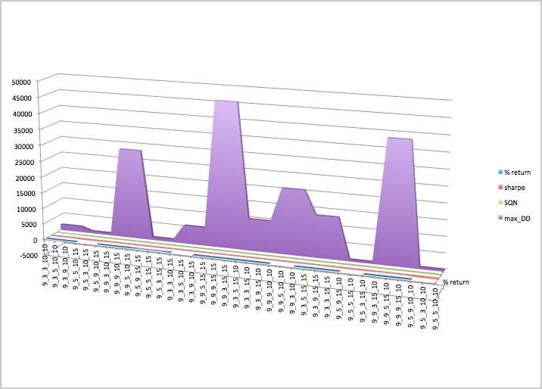
Stochastic reversal
Uses two moving averages lines showing overbought, neutral and oversold zones.
Gives trading signal on extreme levels.
Strategy returns were mostly negative.
Small positive returns in some cases.

Slide 13
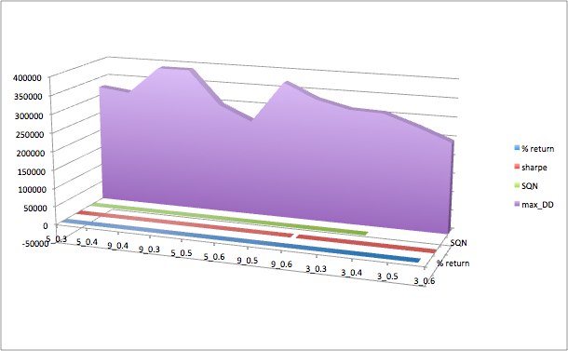
Three Green Candles
Predicts reversal of downtrend.
Patterns consists of three consecutive long bodied candlesticks that open within previous candle’s real body.
Strategy returns in -0.11% to 12.43% range.

Slide 14
Your Contribution
Project was done in a group.
Following members contributed to the project:
Aditya Prasann
Raghvendra Goyal
Nilbabul Patel
All members contributed to every aspect of the project in various capacities. However, group members had special contributions in following areas:
Documentation: Aditya Prasann
Coding : Raghvendra Goyal
Presentation and Peer review feedback: Nilbabul Patel

Slide 15
Conclusions
Various strategies yielded returns in wide ranges.
TRIX was most successful strategy with highest returns at 21.99%
SMA and Stochastics strategies returns were mostly negative and rejected as a result.

Slide 16
Future Scope of Work
Three Green Candles and TRIX were most successful strategies.
Further review and refinement can be implemented in following areas:
Reduce transaction cost by refining strategy to lower numbers of trades.
Further investigate more model factors.
Regime modelling for capital allocation.
Out of sample testing to test robustness of model

